Slide 1
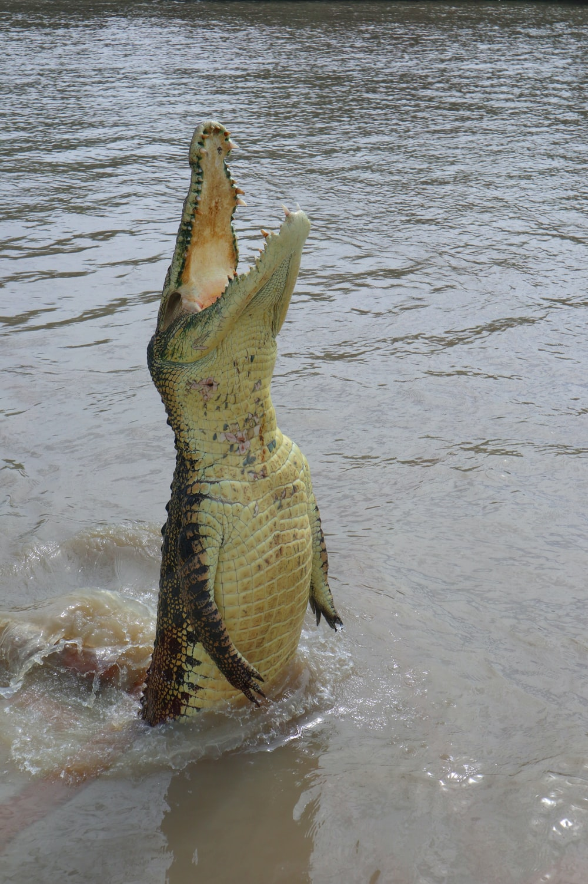

Modern statistics knowledge and skills: what you need and how to get it
Some challenges, thoughts, and solutions
Ed Harris
Harper Adams University
2024-10-04

Slide 2
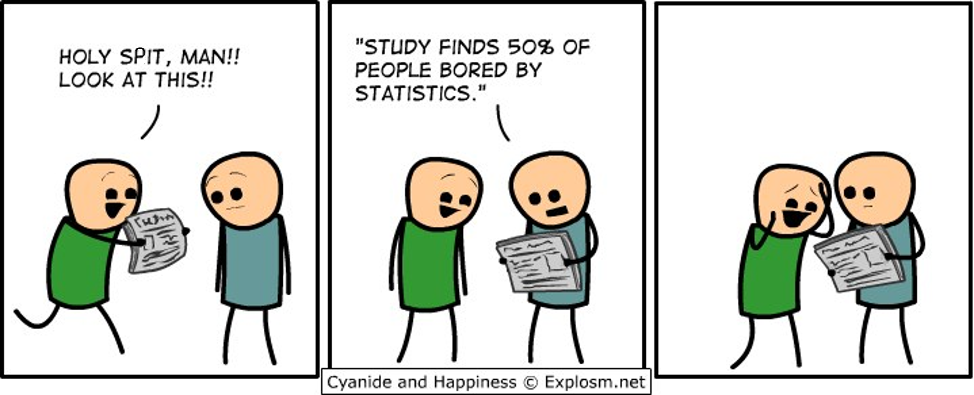
What skills do we need?

Slide 3
What skills do we need?
General minimum:
Ability to engage in "statistical thinking" (Claims and Evidence; Data and Stories)
Ability to design and perform data collection and analysis
Which is more important? Which is harder?

Slide 4
What skills do we need for best practice?
Specific minimum:
Open & "Tidy" Data , Reproducible practice
Traditional stats (regression, ANOVA, etc.)
Effect size and power
Linear models, generalized linear models (GLM), linear mixed effects
Model selection/likelihood, AIC
Spatial autocorrelation and how to deal with it

Slide 5
Tidy data
Practice of tidy data + data dictionary
-usually Excel
-rows are observations
-data dictionary
-no embedded stuff
Wickham 2014 ('Rockstar' statistician)

Slide 6
Tidy data
Store data in an accessible software format
Spreadsheet programs to develop the text files (Google Sheets, Excel, FreeOffice, LibreOffice).
For example: use comma- or tab-delimited text ﬁles.
Text files can always be read, whereas proprietary formats can become unavailable in future.
Store data in nonproprietary hardware formats
Keep data on the internet, which probably won’t die soon.
Backup copies at another location.

Slide 7
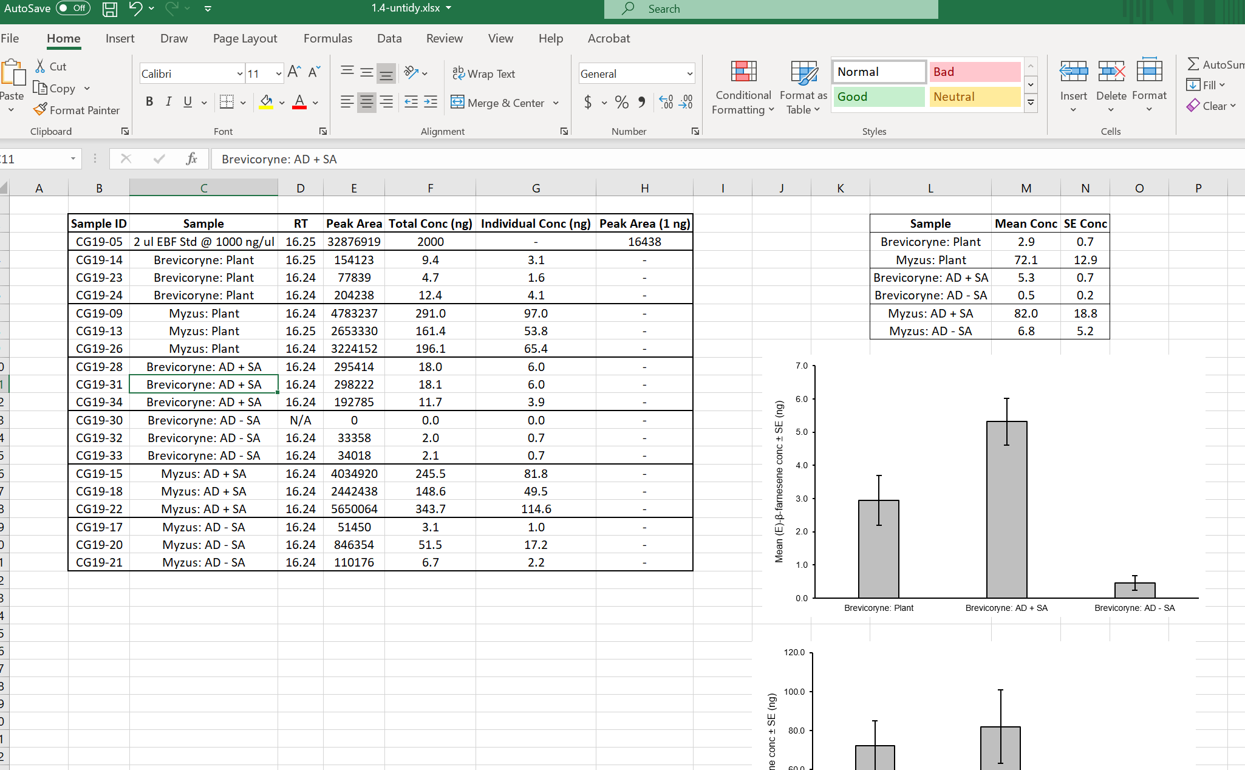
Tidy data

Slide 8
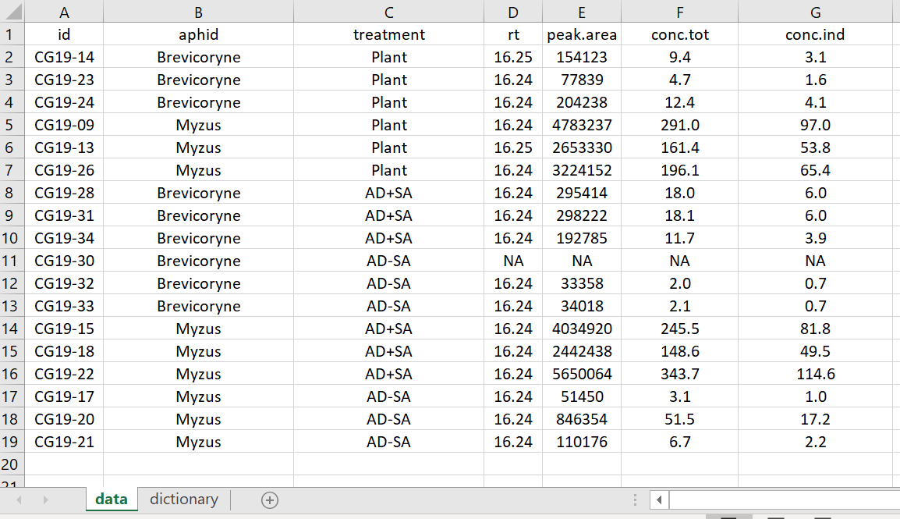
Tidy data

Slide 9
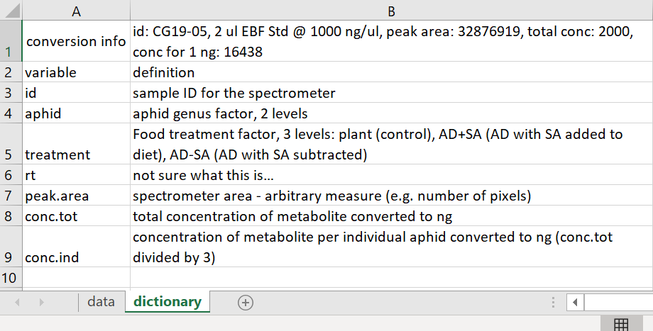
Tidy data

Slide 10
Further data recommendations
Leave your data ﬁle raw and uncorrected, with all warts
Otherwise, you might change something that you later discover was correct; reduces reproducibility erasing assumptions
Make corrections instead using an open scripting language (e.g. R) so you have a record, and can undo later if necessary
Corrections directly to the data file go unrecorded – you have no record of the change you made
Keep comments in your script (command) file that explains reasons for corrections, so you can redo or reevaluate later

Slide 11
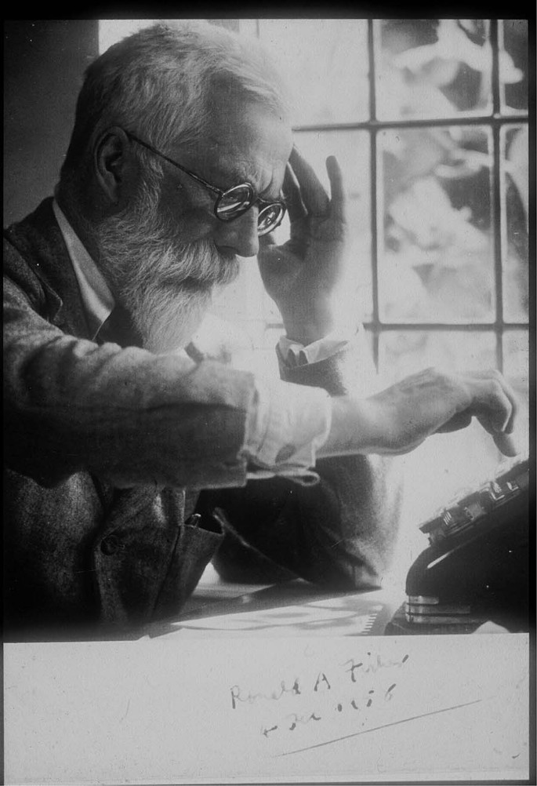
Reproducible practice
I expect your analysis to be reproducible…
Your analysis and data can be used in the future to EXACTLY reproduce your results:
By your future self
By a colleague
For posterity, for meta analysis
By someone you have never spoken to, greatly respect, and perhaps slightly fear

Slide 12
Reproducible practice
What does it look like?
Use open source, scripted software for analyses and store data in an open format
Reproducibility, collaboration, data in tidy format

Slide 13
Reproducible practice
Script-based analysis
For example: R, Python, SAS (SAS, MATLAB are scripted but not open and not free)
Menu-based programs leave no record of the analyses you carried out. You will forget. Menus change. (hence avoid SPSS, Genstat, JMP, etc.)
Script files (commands) become a record of your analyses
Use detailed comments in your scripts detailing your choices and actions
RMarkdown makes human-readable documents with R script, analysis descriptions, and results (e.g., figures, tables)
Consider using version control, which records changes over time so that you can undo or retrieve earlier versions later (e.g., keep script files on Github)
Borer, E. T., E. W. Seabloom, M. B. Jones, and M. Schildhauer. 2009. Some simple guidelines for effective data management. Bulletin of the Ecological Society of America 90: 205-214.

Slide 14
Using and learning
R is a language and software for statistical computing and graphics
R is a GNU Project, free (as in “free beer”, also liberty…) under the terms of the Free Software Foundation GNU General Public License
R was inspired by the S environment, developed at Bell Laboratories (formerly AT&T, now Lucent Technologies) by John Chambers and colleagues
R is the result of a collaborative effort involving contributors from all over the world – 1000s and 1000s of packages of “solutions” (currently ~20,000 packages!)

Slide 15
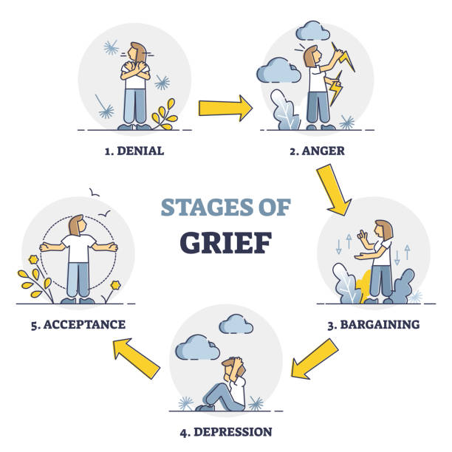
STATS
LEARNING

Slide 16
Challenges
Sharp learning curve especially right at beginning
Data abstraction required
Basic programming concepts useful
Basic computer skills, file management needed
Variation in command "syntax“ style hard for beginners (plot vs ggplot, the “tidyverse”)

Slide 17

Advantages
Fits best practice, free and open, in wide use
Most modern stats software at present
Huge popularity, community
Prevalent even at BSc level in many universities
Confers employability advantage, transferrable skills
Professional development for staff
Easier to supervise (even if supervisor does not use R)

Slide 18
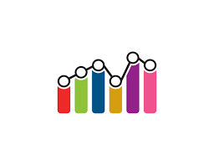

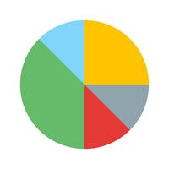
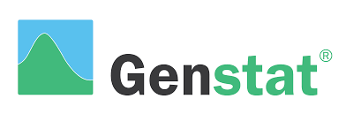



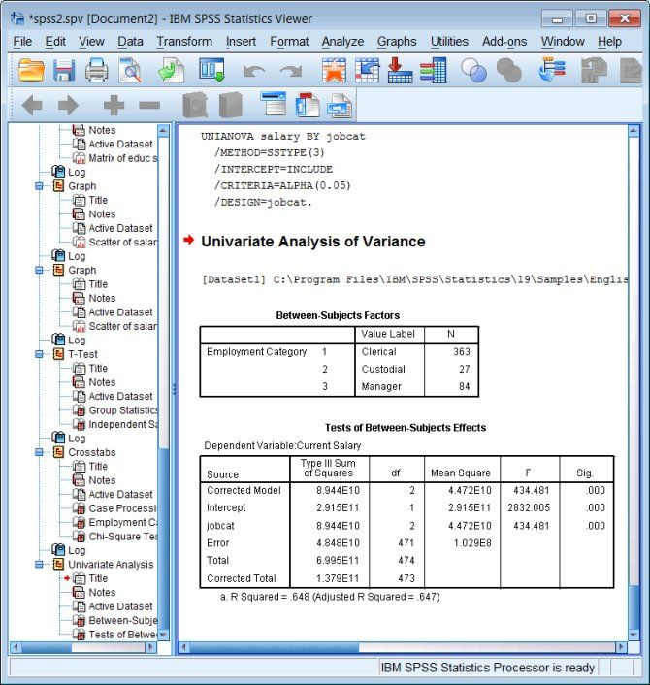
data
Non-reproducible workflow
analysis
report
data 1
data 2
start with
data
fix data
stats software
stats outputs
report
-learning curve ("SPSS is easier" == False)
-report filters analysis - hard to give feedback
-recreating analysis after feedback is time consuming
-no record of analysis (and possibly data) after report turn-in

Slide 19

data
Reproducible workflow
analysis
report
data 1
+
Tidy data
report
-Exact record of analysis and data handling
-Report update is (potentially) instant for large or small suggestions
-You, students, collaborators have record of whole workflow
-Naive collaborators can reproduce, and learn while doing so

Slide 20

What software is best (i.e. R vs SPSS/Genstat/Matlab)?
If it ain't broke, don't fix it
"I've used Genstat for XX years and it does what I want"
"We teach with SPSS and the students have to use it"
"My students can't even spell R
and sure as shucks don't need it!"

Slide 21
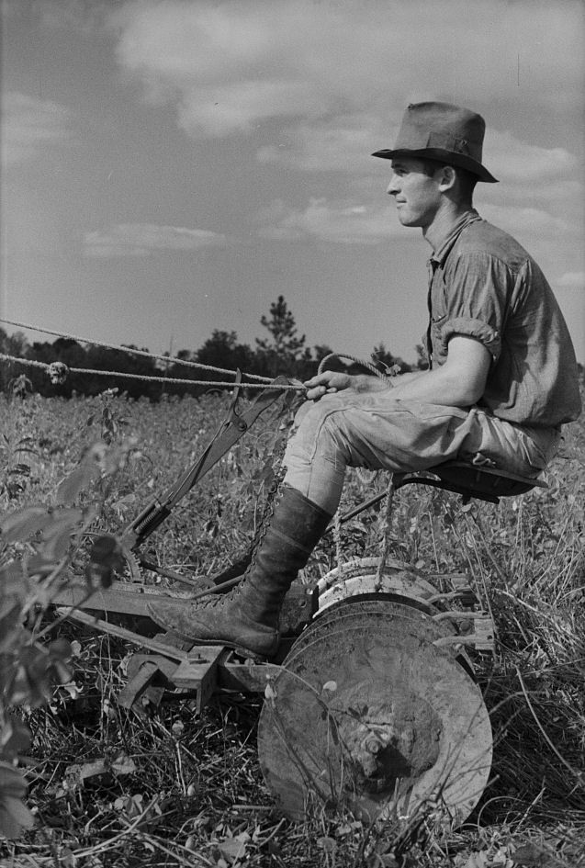
What software is best (i.e. R vs SPSS/Genstat/Matlab)?
Aside from best practice:
Employability for our students at all levels
UK digital skills gap in all sectors
Positioning to lead the HE ag/food sector

Slide 22
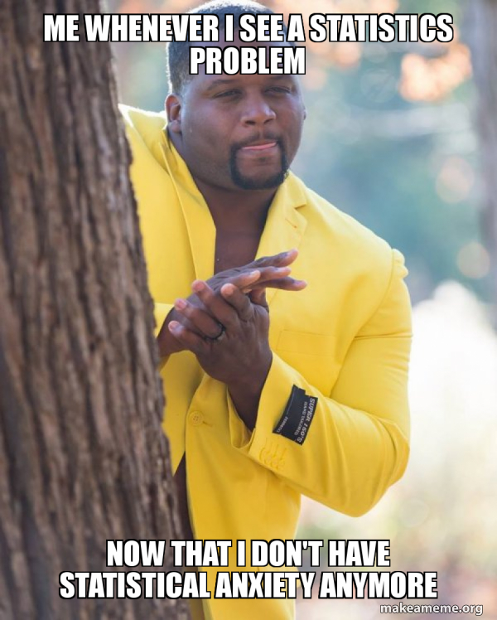
What stats skills do we need?

Slide 23
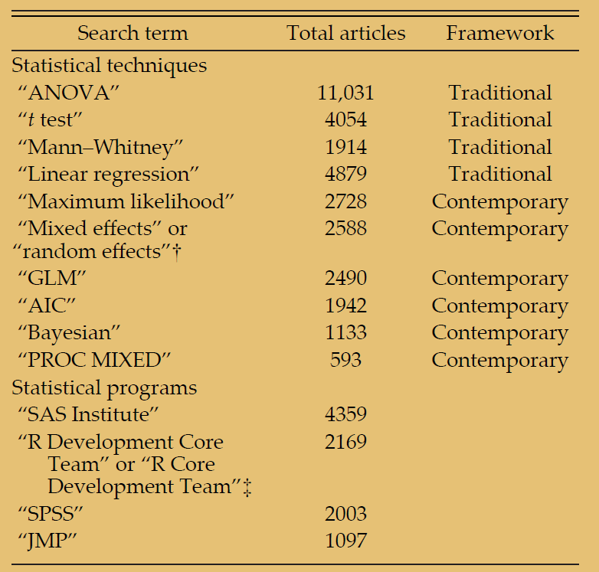
Stats techniques in papers (since 1990)
Touchon & McCoy 2016

Slide 24

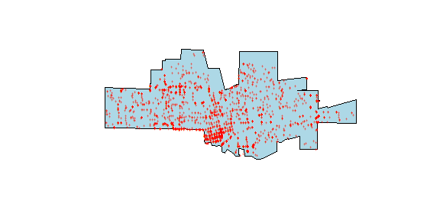


Use of mixed effects
Blocking
Repeated measures
Experimental replication
Spatial data
T1
T2
Group 1
Bess
Block 1
Block 2
Group 2
Sally
Group 3
Block 3
Block 4
Freya

Slide 25
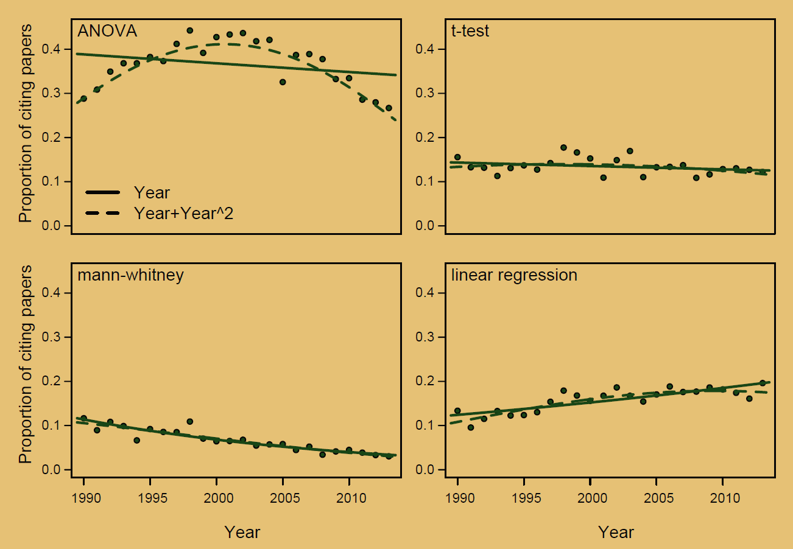
Stats techniques in papers (since 1990)
'Traditional'
techniques
Touchon & McCoy 2016

Slide 26
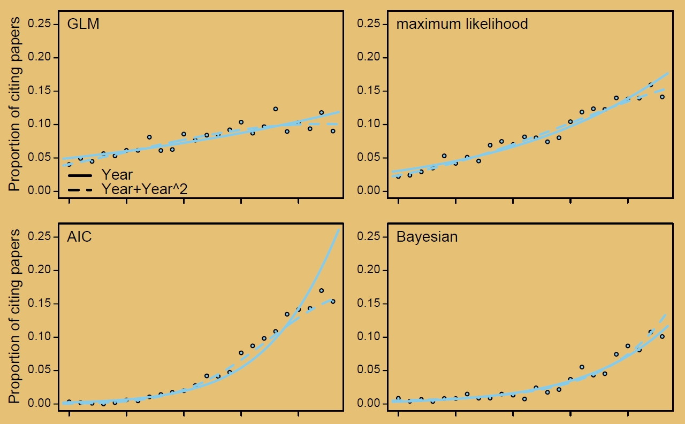
Stats techniques in papers (since 1990)
'Modern'
techniques
Touchon & McCoy 2016

Slide 27
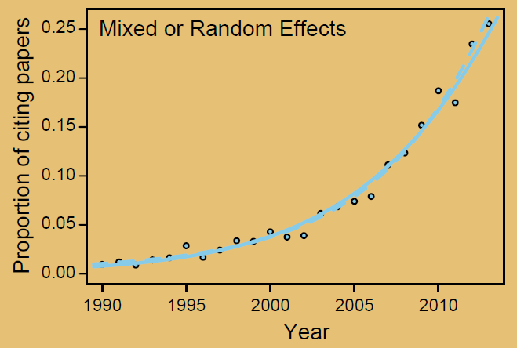
Stats techniques in papers (since 1990)
'Modern'
techniques
Touchon & McCoy 2016

Slide 28
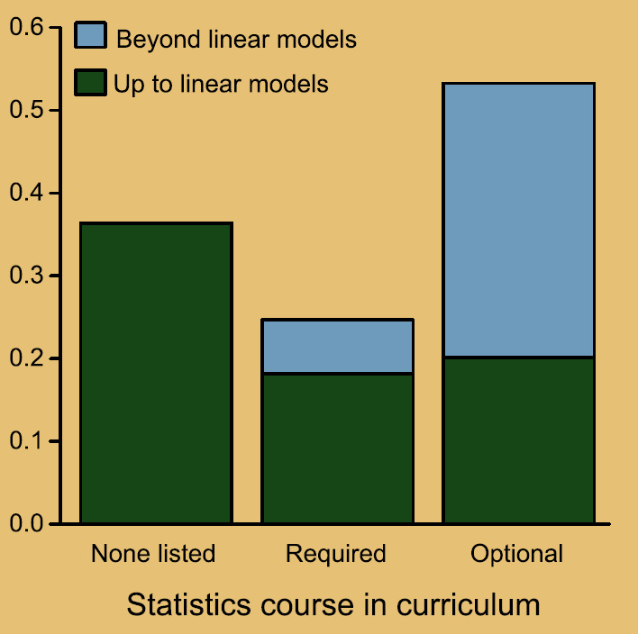
Training in research degrees
Touchon & McCoy 2016

Slide 29
Stats techniques in papers (since 1990)
Touchon & McCoy 2016

Slide 30
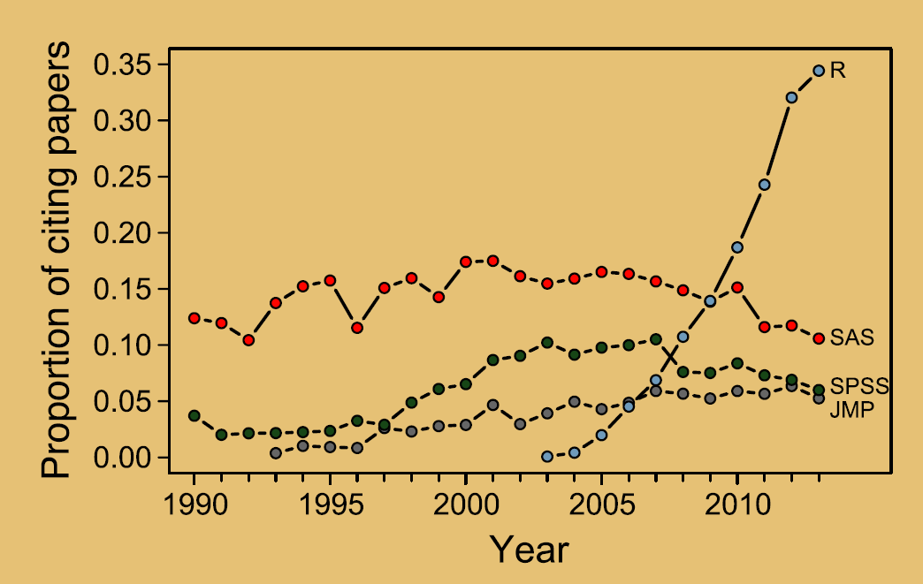
What stats software is cited in papers
Touchon & McCoy 2016

Slide 31
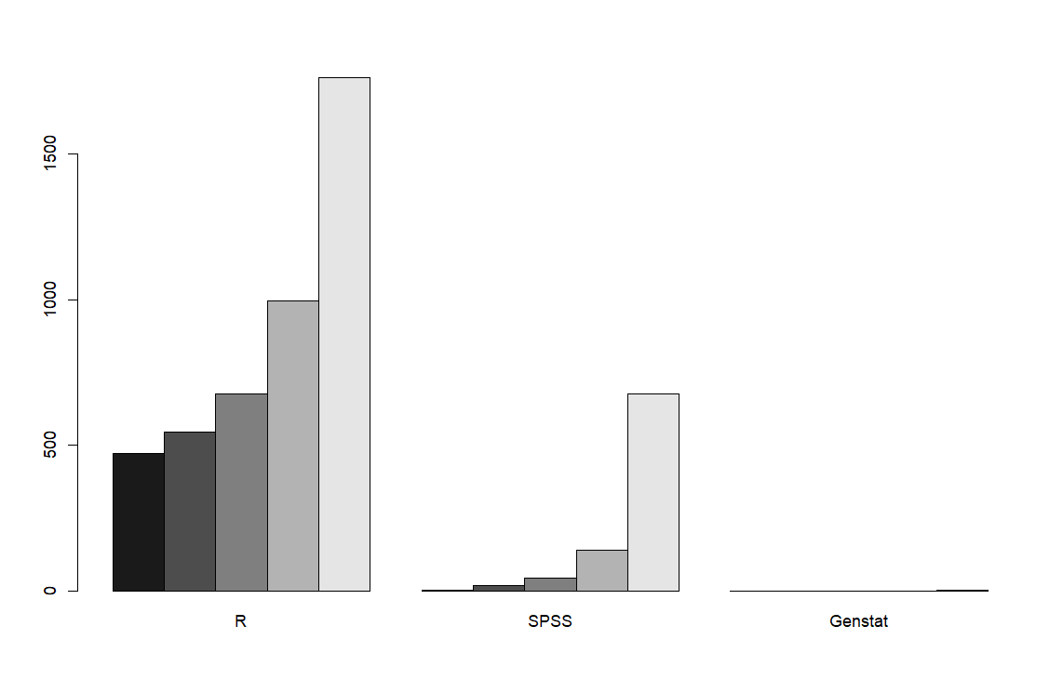
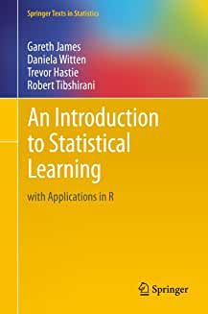
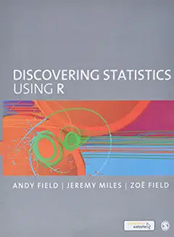
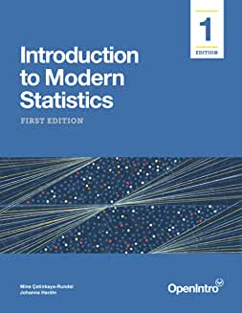
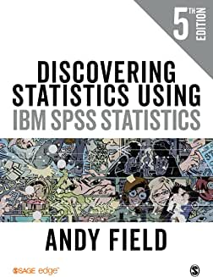
How 'popular' are stats packages?
Count of star-ranked reviews per
package on Amazon
(top 5, each package)

Slide 32
Skills in job advertisements
% Job
advertisements
(in ecology)
mentioning
data + stats + R
Auker & Barthelmess 2020

Slide 33
Models for acquiring stats and R skills
Easier
Engage with community, watch others
E.g. HARUG! Right here at Harper
take a class or short course, buy a book,
YouTube
Teach R + stats
R/stats practice with students
Learn on-the-go with your own data

Slide 34
Models for acquiring stats and R skills
Challenge: Time, Fear, etc.
(we must find time to incorporate our practice into professional development)

Slide 35
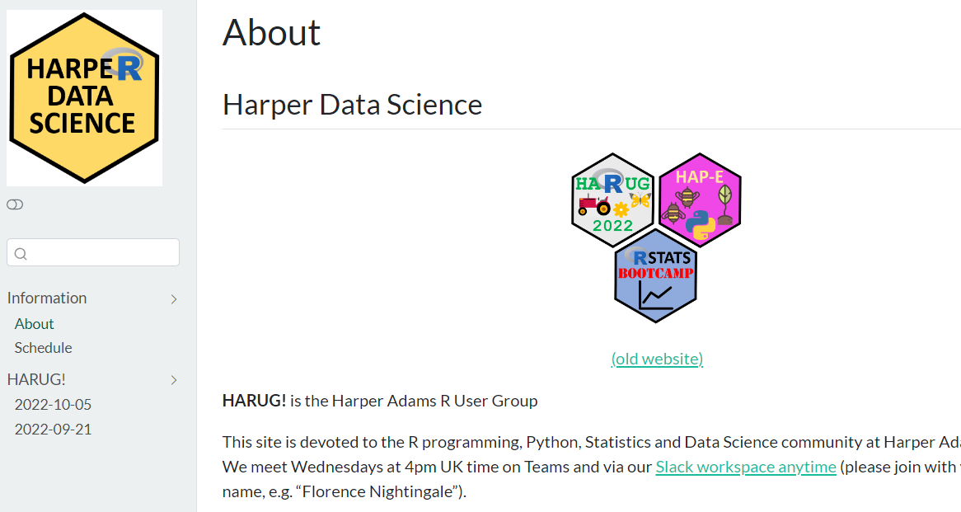
Resources
https://harper-data-science.github.io/website/

Slide 36
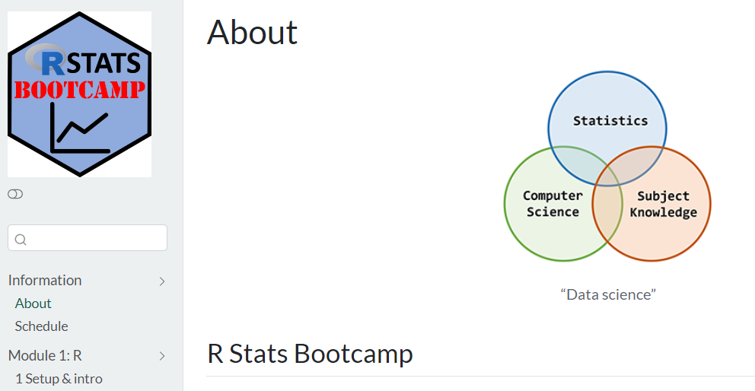
Resources
https://rstats-bootcamp.github.io/website/

Slide 37
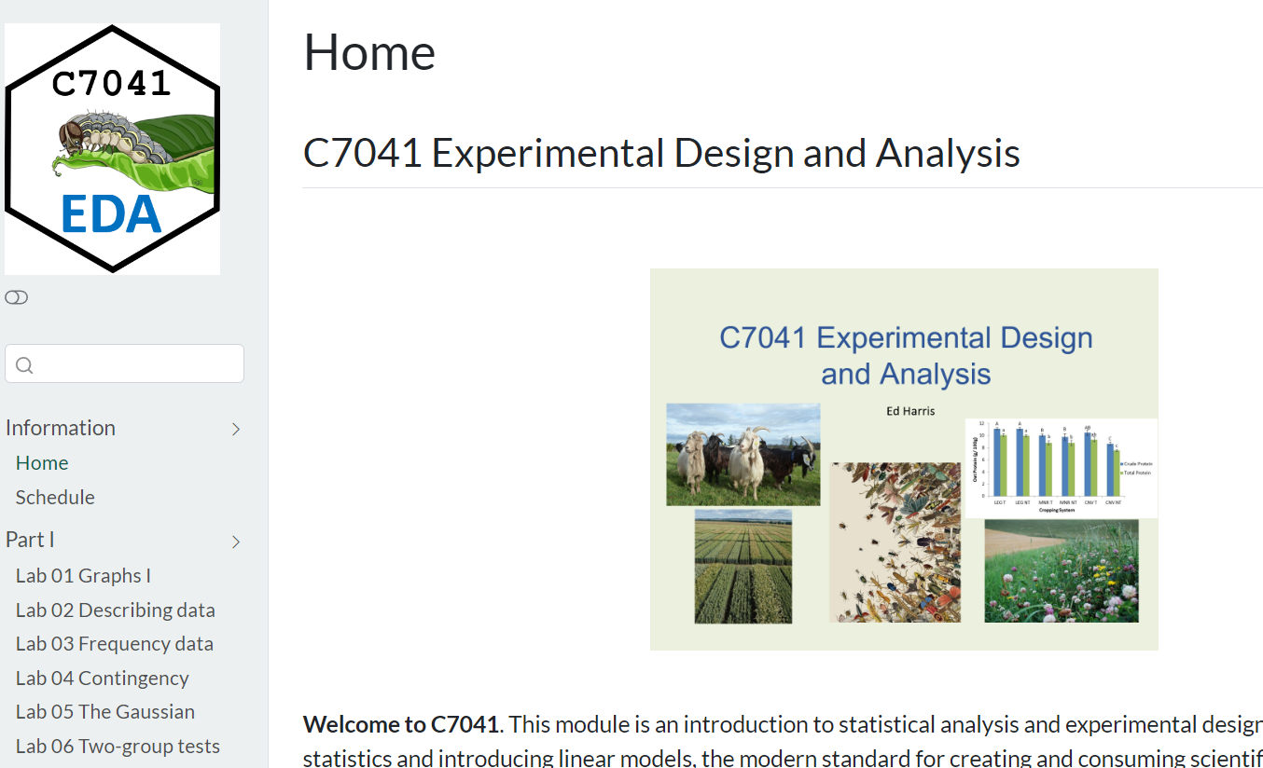
Resources
https://c7041-2022.github.io/website/

Slide 38
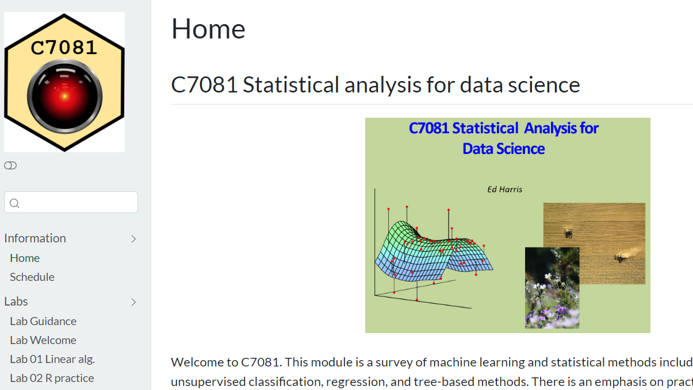
https://c7081-2022.github.io/website/

Slide 39
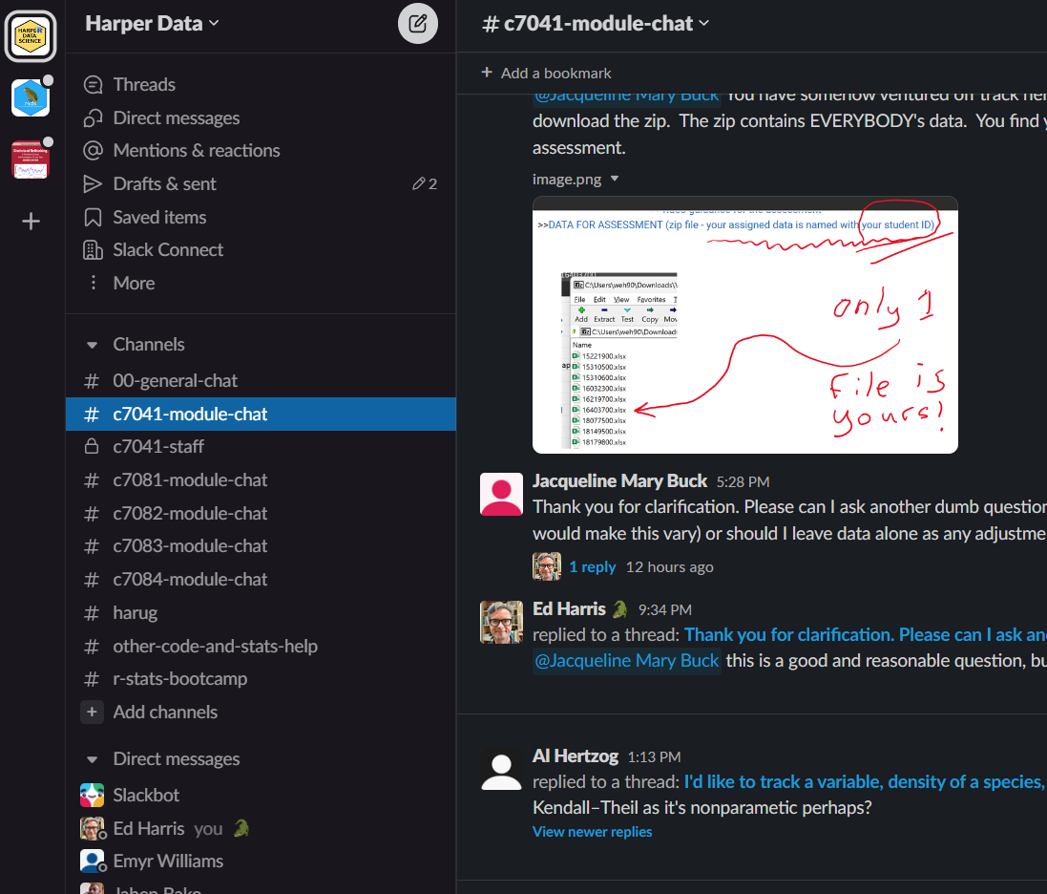
Slack community
https://join.slack.com/t/ha-eda-party/shared_invite/zt-w19od3dz-6bjo~dTC_GQeSUUv3B8XzQ
Founded Jan 2020
-1000s and 1000s of messages
-Harper research stats community
-(also teaching, data science)

Slide 40
10 Recommendations for improving stats/research practice
(use R and tidy data like the rest of the world)
Formal stats training at Harper for research students (mandatory, marked, part of e.g. RD2, not just a "one off")
Formal stats training at Harper for PhD supervisors (high, academic level)
Stats support should be for staff capacity building via research students (also HRP/MRP)
Encourage reproducible, open data practice in research and teaching
Coherent reproducibility and open data strategy at HAU

Slide 41
10 Recommendations for improving stats/research practice
(curriculum review…)
Integrate R and stats best practice at undergrad and MSc levels
Better constructive alignment between 2nd year stats and MRP stats with PROJECT UNITS
(teach and mark) take stats design proposal at HRP and MRP seriously - effect size and power!
3rd Year out ("trail goes cold") - engage in peer review of e.g. HRP stats design
There must be improvement in survey design and analysis practice at all levels

Slide 42
